Slide 1
Revisiting Main Strategies from 2/24:
Discuss how you infused those and provide examples about learning outcomes/student response
Best Practices for ELLs
Focus on language and literacy
Emphasize academic vocabulary
Activate & strengthen background knowledge
Promote oral interaction
Give students feedback on language use

Slide 2
Tools to Separate English Learners’ Learning Difficulty from Learning Disability
Solange Lopes Murphy, Ph.D.
Associate Professor
The College of New Jersey
murphys@tcnj.edu

Slide 3

Is it a Second Language Development Issue or a Disability?
As you watch this short video segment, jot down some of the recommendations made by Dr. Zacarian about strategies to better examine a language difficulty or disability?
Let’s then discuss those points in light of your instructional context.

Slide 4
Learning/Language Difficulty or Learning Disability?
Learner
Instruction
Progress over Time

Slide 5
Learning Disability
It is a condition giving rise to difficulties in acquiring knowledge and skills to the level expected of those of the same age, especially when not associated with a physical handicap.

Slide 6
All external factors should be explored before a “within-in” child condition is considered.
(Klingner & Eppolito, 2014)

Slide 7
External Factors Able to Affect
Second Language Acquisition & Learning
Anxiety
Culture
Family situation
Type of instruction delivered
Internationally adopted children
Life experiences
Literacy
Motivation
Personality
School community
Self-concept
Silent period
Teacher
Other students

Slide 8
Areas of Potential Challenges for ELLs in Mainstream Classrooms
Omits words or adds words
Forgets names of things he/she knows
Becomes distracted easily
Has trouble following directions
Has difficulty with math word problems
Avoids writing
Has difficulty transferring learning from one lesson to another
Very literal – misses inferences, subtleties
Understands but has difficulty showing understanding in writing
Learns better from watching than from listening
Has difficulty categorizing, classifying, or summarizing
Has difficulty providing an oral narrative
Gives up easily or explodes
Hamayan et al., 2013, p. 43

Slide 9
How Can Teachers Better Understand the Background of Their EL Students?
English Language Learners come to our public schools with vastly different backgrounds. They fall into four categories:
Newly arrived students with adequate formal schooling;
Newly arrived students with limited formal schooling;
Students exposed to two languages simultaneously;
Long term English-language learners.
Notes:
When content area teachers understand the varied literacy backgrounds of students, they can better develop literacy assessments. ELL students are not a homogeneity group, these students represent heterogeneous groups. Do not forget how diverse ELLS truly are.

Slide 10
Working with Students with Interrupted Formal Education (SIFEs)
Challenges
  Stress (post-traumatic stress disorder)
    Constant migration, war, lack of access to education
  Literacy and academic gaps
    No literacy in L1 or L2
    Lack understanding of basic concepts, content knowledge, and critical thinking skills
  Frustration
    Despite enthusiasm, the realization of falling far behind is a source of frustration
  High Risk of Dropping Out

Slide 11
How are ELLs different from students with disabilities?
Characteristics | EL | Student with disability
Communication skills | Reduced communicative skills. L1 may lead to misdiagnosis of speech & language. Can become proficient in L2. | May exhibit speech and language disorders. May not become proficient in L1 or L2.
Language skills | L1 skills (verbal & nonverbal) are appropriate prior to L2. May experience silent period prior to speech emergence in L2. | Difficulties in L1. Difficulties in comprehension & expression.
Cognitive abilities | Experience academic difficulties due to cultural difference, limited educational experiences, or differences in prior knowledge. | Cognitive deficits may result in significant educational impact and specialized instructional support is necessary.

Slide 12
How are ELLs different from students with disabilities?
Characteristics | EL | Student with disability
Academic functioning | Problems due to culturally determined learning style, lack of schooling in C1, and different perceptual strategies. | Inability to make progress, difficulty retaining information despite variety of strategies, difficulty in L1.
Progress | Will depend on quality & quantity of L2 instruction. Progress may be slow but steady. | May show less than expected progress. May show discrepancy between different areas (oral vs. writing skills).
Productivity | Lack of understanding may lead to assistance need. | May be unable understand, concentrate, and perform tasks without assistance.
Social abilities | Social problems due to lack of familiarity. May experience social isolation and tend to be a follower instead of a leader. | May show difficulties with social and emotional skills not related to acculturation.

Slide 13

The Interface
ELs’ Profiles
L2 Struggle
Difficulty or
Disability?
Learning
Disability
Best Teaching
Practices for
ELs

Slide 14
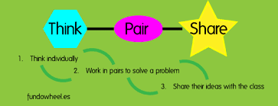
What questions should we start asking ourselves & others when we suspect one of our ELs may have a learning disability?

Slide 15
To whom should the EL student be compared?

Slide 16
Peer Analysis
A peer analysis is critical in determining if the student’s performance is atypical.
The ideal peer group are ELs, same language background, same time in program, same grade of entry in school, & similar profile.

Slide 17
What the research says
As per Goldenberg’s (2008) research for effective practices in ELL instruction:
  The majority of ELs (60%) receive all-English instruction.
  About 12% receive no ESL/ELD services.
  More primary language (L1) instruction over time leads to higher academic achievement in English. In other words, teaching students to read in L1 promotes higher reading achievement in English.
17

Slide 18
What the research says
All-English immersion does NOT lead to rapid English fluency, in contradiction to some state policies (e.g., California, Arizona).
ELs need explicit language instruction and opportunities to speak for genuine communication.
Explicit instruction in skills is what is needed for ELLs to make gains.
18

Slide 19
What the research says……
Research demonstrates that English language learners with the least amount of language support are most likely to be referred to special education
ELLs receiving all of their instruction in English were almost 3X as likely to be in special education as those receiving some native language support
Artiles & Ortiz 2002
19

Slide 20
Categories of ELs Who Experience Academic Difficulties
Those with deficiencies in their teaching or learning environment; lack of effective ELD instruction and support
Those experiencing academic difficulties not related to a learning disability; interrupted schooling, limited formal education, medical problems, low attendance, high transiency, etc.
True ELs with disabilities and in need of Special Education
20

Slide 21
General Recommendations
Before considering any disability, the professional should…
  Avoid judgmental decisions by attributing difficulties to an internal condition
  Explore all the external sources surrounding the learner
    Home context
    Proficiency and literacy in L1
    Behavior outside the classroom
  Use appropriate instructional & assessment practices
  Use lots of intervention strategies & observe growth over time

Slide 22
Examining Sources of Difficulties: Steps
Generate an inventory of specific observable behaviors
  Avoid broad statements
    Example: “The student has difficulty comprehending”, instead “When I read a story, the student has difficulty retelling the events of the story back in English.”
Explain the observed behaviors
  Possible ELL Explanation
    Example: “The student may not understand because the language and cultural context of the story is unfamiliar to him/her.”
  Possible SPED Explanation
    Example: “The student may have difficulty understanding abstract vocabulary or may have limited memory capacity.”

Slide 23
Pre Referral Steps for ELs
Step 1: School Environment
Examine whether appropriate instruction for ELs is being implemented
Step 2: Pre referral intervention or RtI
Determine if pre referral interventions are appropriate, have been implemented, and documented over time
Step 3: Referral to Special Education
Assess in native language & English and other best practices for bilingual assessment to rule out language difference versus disability
23

Slide 24
It is important for ELs that…
ELD instruction continues until student reaches a level 4 and possibly level 5
Instruction should emphasize listening, speaking, reading & writing
Instruction explicitly teaches vocabulary, syntax, grammar, language & content functions
Instruction integrates meaningful and interactive activities via explicit and direct teaching of academic & conversational language
Saunders & Marcelleti, 2013
24

Slide 25
What research says…
Provide students corrective feedback on form
Use of English should be maximized with native language strategically incorporated
Instruction should include communication and language-learning strategies
Instruction should be planned and delivered with specific language objectives in mind
  Saunders & Marcelleti, 2013
25

Slide 26

Interventions to Prevent Over Identification of ELs for SPED
Screen for reading or other academic problems and monitor progress early & provide intensive, small group reading instruction
Provide extensive & varied vocabulary instruction
Develop academic and conversational English
Schedule regular, peer-assisted learning opportunities
Gersten, 2007

Slide 27
Recommended Multi-Tiered
Model for ELs
Referral
to
Special
Education
Tier III
•Frequent, intensive,
Evidence-based
intervention
•Lower student/teacher ratio
•Frequent progress monitoring
•Longer duration
Tier II
•Research based intervention
•Small groups
•Progress monitoring
Tier I
Monitor & track academic & language acquisition growth
Conduct universal screening to determine student risk levels
Provide core research based reading program & EL services

Slide 28
Instructional Strategies for ELs

Slide 29
“Schools are like airport hubs; student passengers arrive from many different backgrounds for widely divergent destinations. Their particular take offs into adulthood will demand different flight plans.”
(Levine, 2002, p. 336)

Slide 30
Knowledge, skills, and attitudes
What can be differentiated?
Content
Product
Process
Physical Space
Learning activities
& strategies
Complexity of product

Slide 31
Teacher
Station 1
Inboxes
Bookshelf
Teacher Station 2
Schedule
Group
Assignments
Notes:
Tell participants that this slide presents one example of how a differentiated classroom could be set up. This setup can be used at the elementary or secondary level. Make the following points for this slide:
The teacher station is for working with small groups. All needed materials are on the shelf behind the teacher so that teacher and students can stay in one place (not get up to get things) during that group work time. Teacher station 2: If you are lucky enough to have a coteacher or a paraeducator working with you, setting up a second teacher station provides them with the same kind of space. If you don’t have another adult, you can use this space for student small group work or a learning station.
Desks (purple squares) can be manipulated so students can work independently, in small groups, or in pairs. Each student should, if possible, have a “home base” desk that they go to when they first come to class. Note: facilitator should also mention that if students are being expected to work in groups and move from one work area to another, these processes must be explicitly taught and practiced.
The inboxes can be used to store materials or as places where students turn in work. Think about labeling them by subject area for elementary school or by class period for secondary students. Color coding materials can also help students find things quickly without teacher assistance. For example, all math books are red or all 2nd-period journals are yellow. Organize things on the bookshelf this way as well.
Always keep a schedule and student group assignments posted. Students should be able to figure out where they are supposed to be and who they are working with without having to ask the teacher.
The red hexagons represent pillows; give students opportunities to work on the floor if it meets their learning profile. Create structure around this (for example, they pick one place and stay there for a defined time period), but allow students to be comfortable when they work. It will help motivate.

Slide 32
Assessment of ELs
Documenting all instructional strategies used
Documenting differentiated instruction and intervention techniques used
Describing in detail & documenting instances of unresponsiveness to differentiated and intervention strategies
Consulting & collaborating with a special education and an ESL professional

Slide 33
Sheltered Instruction
SIOP
Language & Literacy
General Learning Skills
Academic Content
Co-Teaching
& Collaboration

Slide 34
SIOP: Components
Lesson Preparation
Building Background Knowledge
Comprehensible Input
Strategies
Interaction
Lesson Delivery
Practice/Application
Review and Assessment

Slide 35
SIOP Component 1:
LESSON PREPARATION
Ensuring rigor and relevance

Slide 36
Lesson Preparation
Objectives
Content Objectives
Language Objectives
Content Concepts
Supplementary
Materials
Adaptation of
content
Meaningful Activities
Notes:
SIOP mini-lecture: Explain each feature of Lesson Preparation.
Content and language objectives are given equal importance. This is a crucial point in the success of SIOP – This is a key distinction between SIOP and regular content instruction. You may be doing this, but not explicitly and it needs to be explicit.
Ask participants why the above 5 features (objectives, content concepts, supplementary materials, adaptation of content, meaningful activities) are important features when planning a lesson for LEP students. Ask participants what else they do to prepare for a lesson.

Slide 37
Lesson Objectives: Samples
Content Objectives (What)
  Students will identify the basic goods and services a family needs for everyday life. (2nd grade Economic Literacy 6.5.A.1.)
Language Objectives (How)
  In pairs, students will read about the basic goods and services a family needs for everyday life.
  Students will write about one of his/her families basic goods and/or services and share out loud with classmates.

Slide 38
Reading:
Differential Definition
Read
Being read to
“Reading” through picture walk
Foreshadowing
Reading independently

Slide 39

Writing:
Differential Definition
Drawing
Copying
Fill in gaps
Free writing

Slide 40
Language Objectives
Determine the Language Function
  Name
  Describe
  Classify
  Compare
  Explain
  Predict
  Infer
  Suggest
  Evaluate, etc.
  Identify Language Structure(s)
  Sentence Starter
  Cloze sentence frame
  Key Vocabulary-
  Content vocabulary,
  connectors, prepositions, adjectives
  “Real-Life” Mini Language Lesson- grammar

Slide 41
Why Language Objectives?
Academic achievement requires academic language proficiency.
Academic language proficiency involves the vocabulary, language patterns, and register specific to individual content areas.
Notes:
Both language and content teachers are often surprised at the expectation that they are to integrate language and content. This is understandable as there is little attention to language needs in a content teacher’s preparation courses, and for language teachers little attention to the language of academic subjects or to the practical concerns of needs analysis, text adaptation, or collaborative teaching. SIOP is the perfect application for collaboration and cooperation between the ESL language teacher and the content teachers. They can build on each other’s knowledge.
Vocabulary: define “table”; now at your table define “table” in math, social studies, science, English (table of contents)
Language patterns: Let’s look at math
Twice as many… 25 less students liked… 1/8 of the total…
A register is a subset of a language used for a particular purpose or in a particular social setting. For example, an English speaker may stick more closely to prescribed grammar, pronounce the “g” in an “ing” ending, and avoid using the word "ain't" when speaking in a formal setting, but the same person could disobey these rules in an informal setting.
How do I determine language objectives?
Look at task student is required to perform to master content objective
Look at English Language Development Standard Course of Study for the language these tasks require.
From these 2 sources you will be able to write language objectives.

Slide 42
Academic Language
The discourse used in academic, professional and technical contexts that is characterized by its high level and often discipline-specific vocabulary and rhetorical styles.
Mary Schleppegrell

Slide 43
Academic Language
(Guadalupe Valdés)
Language valued at school
Students need it to understand explanations & presentations of
  classroom/school rules, routines, procedures
  subject matter information
Ask and answer questions in the classroom
Understand & participate in class discussions

Slide 44
Academic Language
Understand texts and materials
Complete projects & written assignments
Demonstrate learning through
  Oral presentations
  Written examinations
Notes:
Refer to Jim Cummins articles in Resource Packet: Accelerating Academic Language Learning: Getting Back to the Real Basics in Teaching English Learners.

Slide 45
Academic Language: Examples
Nouns | Qualifying Words/Phrases | Verbs
Table Evidence Function Opportunity Outcome Reaction Role Factor Impact | According to the text, In contrast, Meanwhile, Significantly Due to the fact, Generally, | Argue Analyze Convey Demonstrate Examine Include Involve

Slide 46

History: Challenges
High lexical density (the # of words per clause)
Complex sentence structure
Extensive nominalization

Slide 47

Math: Challenges
There is misguided belief that math is less difficult for ELs.
Variety of meaning making systems – symbols, graphs, written and spoken language characterized by technical vocabulary and complex grammatical features
Specialized meanings for words
Imperfect transfer of math knowledge from one language to another
Linguistic abstraction

Slide 48
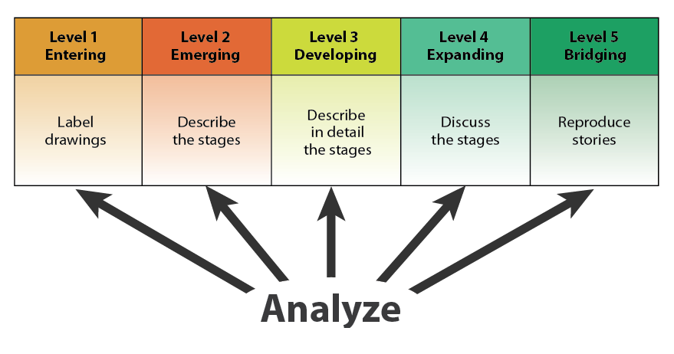
Differentiation:
Cognitive Function & Language Output
*Point to pictures
*Name pre-taught objects
*Make sound/symbol relation
*Copy word, label
*Arrange pictures per oral information
*Describe pre-taught objects
*Identify facts
*Fill in graphic organizers
*Role play the text *Answer opinion questions
*Classify features of the text
*Take notes using graphic organizers
*Express opinion from oral scenario
*Explain with evidence
*Summarize information
*Connect to personal experiences
*Identify main ideas
*Make predictions
*Use context cues to determine meaning of words
Recount
Identify
Describe
Notes:
Important to remind participants here that underlying the language function (communication process) is the cognitive demand, which is applicable across all levels of English language proficiency.

Slide 49
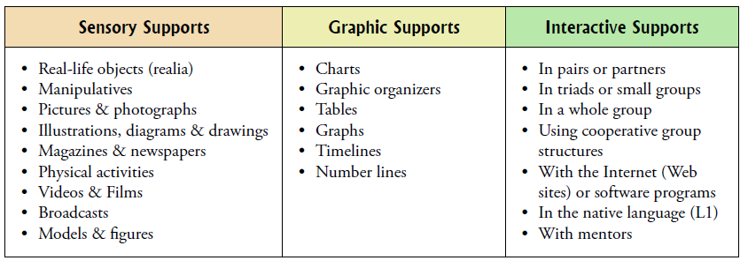
Support Examples
Notes:
Instructional supports illustrate the importance of scaffolding language development for ELLs, at least through level 4.
WIDA categorizes supports as sensory, graphic, or interactive, with some examples of each provided in the table. These can be found the in the 2007 Edition of the WIDA ELP Standards.

Slide 50
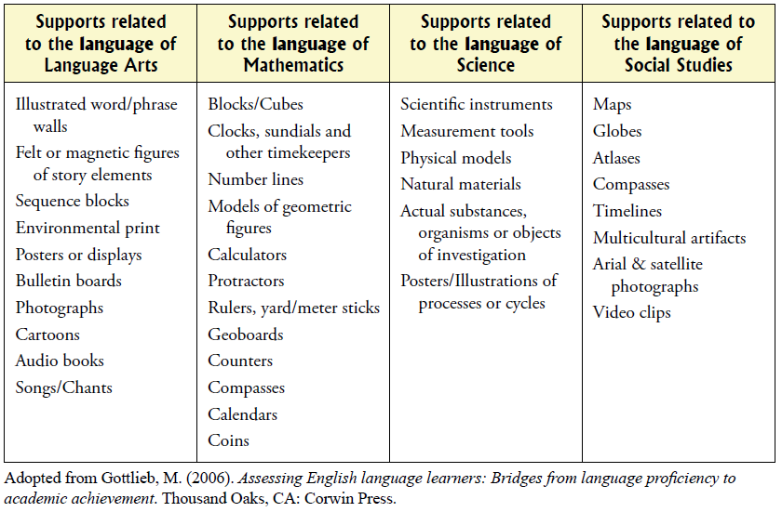
Specific Examples of Sensory Supports
Notes:
Here are specific examples of the supports used in different content areas. These lists are not exhaustive. This graphic can be found in the 2007 Edition of the WIDA ELP Standards.

Slide 51
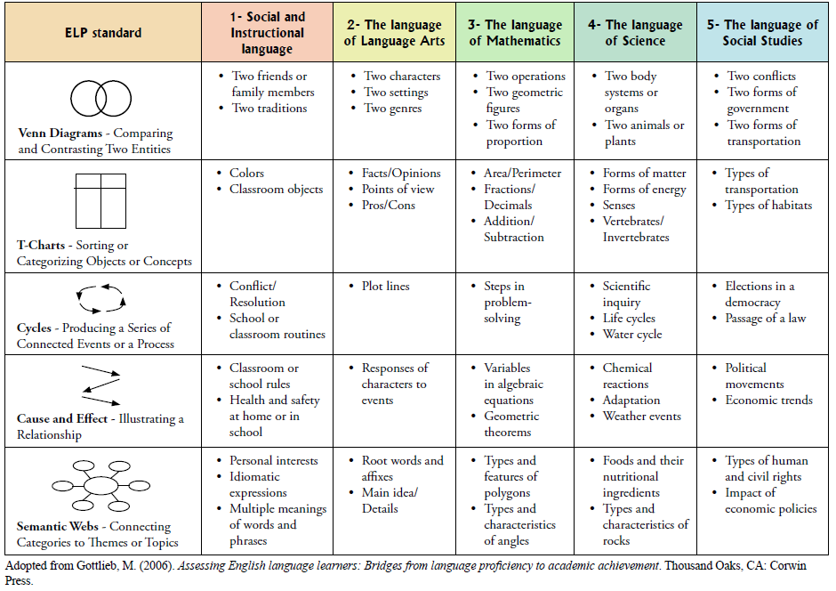
Example Use of Graphic Organizers
Notes:
Students might refer to graphic organizers as they read to remind them of key language related to each narrative point of view. This graphic can be found in the 2007 Edition of the WIDA ELP Standards.

Slide 52

SIOP Component 2:
BUILDING BACKGROUND

Slide 53
Building Background Knowledge
Building Background
Connect to
Student’s Prior Experiences
Connect to Past Learning
Emphasize Key Vocabulary

Slide 54
How do you approach vocabulary instruction in your classes?

Slide 55
Marzano’s Characteristics of Effective Vocabulary Instruction
Use student friendly descriptions, not definitions
Use linguistic and nonlinguistic representations (gestures, draw pictures)
Gradually develop word meanings (discuss what they mean in different contexts)
Teach students how to use word parts
Use different types of instruction for different types of words
  Example: verbs always show a relationship between two nouns so explicitly tell the students this
Students need to discuss the terms they are learning
Use games
Focus on academic vocabulary relevant to the curriculum being taught
Notes:
1.When people first learn words they understand them more as descriptions of words as opposed to definitions.
2.Linguistic/nonlinguistic – remember the dual coding theory we talking about earlier
3.Vocabulary knowledge seems to grow gradually, moving from the first meaningful exposure to a word to a full and flexible knowledge.” Stahl (1999 in Marzano p73)
4.Teaching parts of words can enhance student understanding of new terms.
5.Just read off the slide
6. As students discuss terms, they are encoding the information into their own words; this allows the students to have a deeper understanding of the word and it increases the chance that the information will be stored into permanent memory.
7.Make learning words fun!
8. Just read off the slide

Slide 56
Marzano’s Steps to Guide
Vocabulary Instruction
Step 1 – Teacher describes the vocabulary term.
Step 2 – Student writes their own description of the term.
Step 3 – Student creates nonlinguistic representation of the term.
Step 4 – Students periodically do activities that help them add to their knowledge of vocabulary terms (word sorts, concept definition maps).
Step 5 - Students discuss terms with peers.
Step 6 – Students play games using the terms.
Notes:
1.Teacher provides a conversational description, explanation or example of the new term.
2. Students restate the explanation of the new term in their own words. Students create their own explanation of the term based on what the teacher presented. This is to be recorded in an academic notebook, in the vocabulary section under the area titled my description.
3. Student creates a non-linguistic representation of the term using pictures, webs or graphic organizers. Students create this non-linguistic representation in the appropriate section of the notebook.
4. Students periodically engage in activities that help expand their knowledge of the vocabulary terms (comparing, classifying, generating metaphors, generating analogies, revising initial descriptions/non-linguistic rep., applying knowledge about affixes to the root words) New insights can be added to their notebooks.
5. Students discuss terms with peers from time to time. To stimulate discussion the teacher might pose questions each group will address
6. Students will occasionally engage in games that will allow them to play with the terms. Teachers can use games as a way to reinforce understanding or
as five minute sponge activities to stimulate interest and enthusiasm about the vocabulary and to maximize the amount of time on task.

Slide 57
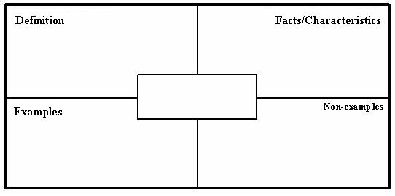
Four Square Vocab Model
Notes:
This basic four square model of vocabulary instruction can be adapted for various grade levels and content areas.

Slide 58

Flyswatter Game
Post words from a unit on cards and put them on the wall or write them randomly on the board.
Give 2 students a flyswatter.
Describe the word and see who can swat the word first.
Pass the flyswatters on to two more students.
You can make it competitive with teams.
Notes:
We need two volunteers to come up and participate in our flyswatter game.
You can have all the students participate at once.
You could have kids pair up and at their tables compete against one another as you describe the word.

Slide 59
Situation Generation
Pose a question using the target vocabulary and have students create a situation that applies.
For example:
*Describe the setting of a story you recently read.
*What would be an example of a proper noun?
*Give me an example of when you would want to estimate an amount instead of finding the exact amount.
This is a good 5 min filler or a morning gathering sharing activity!

Slide 60
SIOP Component 3:
Comprehensible Input
Increasing accessibility

Slide 61
Making Input Comprehensible
To Make Input Comprehensible
Appropriate Speech
Modeling & Visuals
Clarity

Slide 62
Activity: Math
Brainstorm ways to make this content comprehensible to ELs.

Slide 63
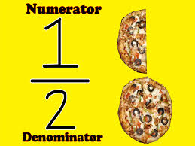
Fraction
Word Problem
1/3 of a pole is painted red.
1/2 of it is painted blue.
Three feet of the pole is painted green.
What is the height of the pole?
http://www.mathplayground.com/wpdatabase/Fractions2_3.htm

Slide 64
SIOP Component 4:
Learning Strategies
Increasing accessibility

Slide 65
Learning Strategies:
What is involved?
Learning Strategies
Cognitive & Metacognitive Learning Strategies
Scaffolding Techniques
Variety of Questioning

Slide 66
1. Learning Strategies
Cognitive:
Rereading
Highlighting
Reading Aloud
Taking notes
Mapping information
Finding key vocabulary
Mnemonics
Metacognitive:
Predicting / Inferring
Self-questioning
Monitoring / clarifying
Evaluating
Summarizing
Visualizing

Slide 67
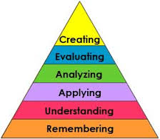
Bloom’s Questions
Knowledge: Who is the author of the poem?
Comprehension: Outline the main events in the story.
Application: Write a list of interview questions you would ask if you had the opportunity to talk to the narrator.
Analysis: Select a word or phrase from each stanza of the poem. How do these words / phrases contribute to the story?
Synthesis: Imagine that you had been the person who found the dead deer. Write a new stanza for the poem, telling what you would have done.
Evaluation: Did the narrator make the right choice? Why or why not?

Slide 68
Hierarchy of Questions: Considering Language Output
From easiest to hardest:
1. Point to
2. Yes/No
3. Either/or
4. Wh-
5. Open-ended

Slide 69
SIOP Component 5:
Interaction
Creating Opportunities to Use Academic Language

Slide 70
Interaction
Opportunities for Interaction
Group Configurations
Wait Time
Use of L1 to Clarify Concepts

Slide 71
Cooperative Learning Activities
1. Information Gap Activities | 7. Story summaries
2. Jigsaw | 8. Literature study groups
3. Four corners | 9. Writing headlines
4. Numbered heads together | 10. Science & math investigations
5. Round robin/roundtable | 11. Think, pair, & share
6. Questionnaires & interviews | 12. Debates

Slide 72

What can teachers do to structure academic interaction?
Pose a concrete task and clarify the task
Model an appropriate response using a starter.
Identify vocabulary, content, grammar needed to complete the starter.
Monitor student’s process and offer assistance
Provide an example of how this can be done
in a particular content area.
Notes:
Teachers often say they don’t use cooperative learning because students don’t stay on task. Therefore explain structuring activity.

Slide 73

Why & when is it important to use the student’s native language in the class?

Slide 74
SIOP Component 6:
Lesson Delivery
Increasing accessibility

Slide 75
Lesson Delivery
Support Content Objectives
Support Language Objectives
Student Engagement
Appropriate Pacing

Slide 76

Activity
• You will watch a short SIOP teaching segment.
Please review the questions below and be prepared to discuss them after you’ve watched it.
1. What did the teacher do in this lesson to engage the students?
2. Explain how you would determine if the students knew how to distinguish fact and opinion by the end of the lesson?
3. Are there any things you would do to improve this lesson delivery?
Notes:
Give teachers 3 minutes to share and when they come back – do a beach ball toss – If they get the negative facing them, what is a challenge they face and ideas they have to meet this challenge: if they get the positive sign facing them, what are some classroom routines that have helped them to maximize student time on task?

Slide 77
SIOP Component 7:
Practice & Application

Slide 78
Practicing & Applying Content & Language Knowledge
Integration of All
Language Skills
Hands-on
Practice with
New Knowledge
Application of
New Knowledge in
New Ways

Slide 79
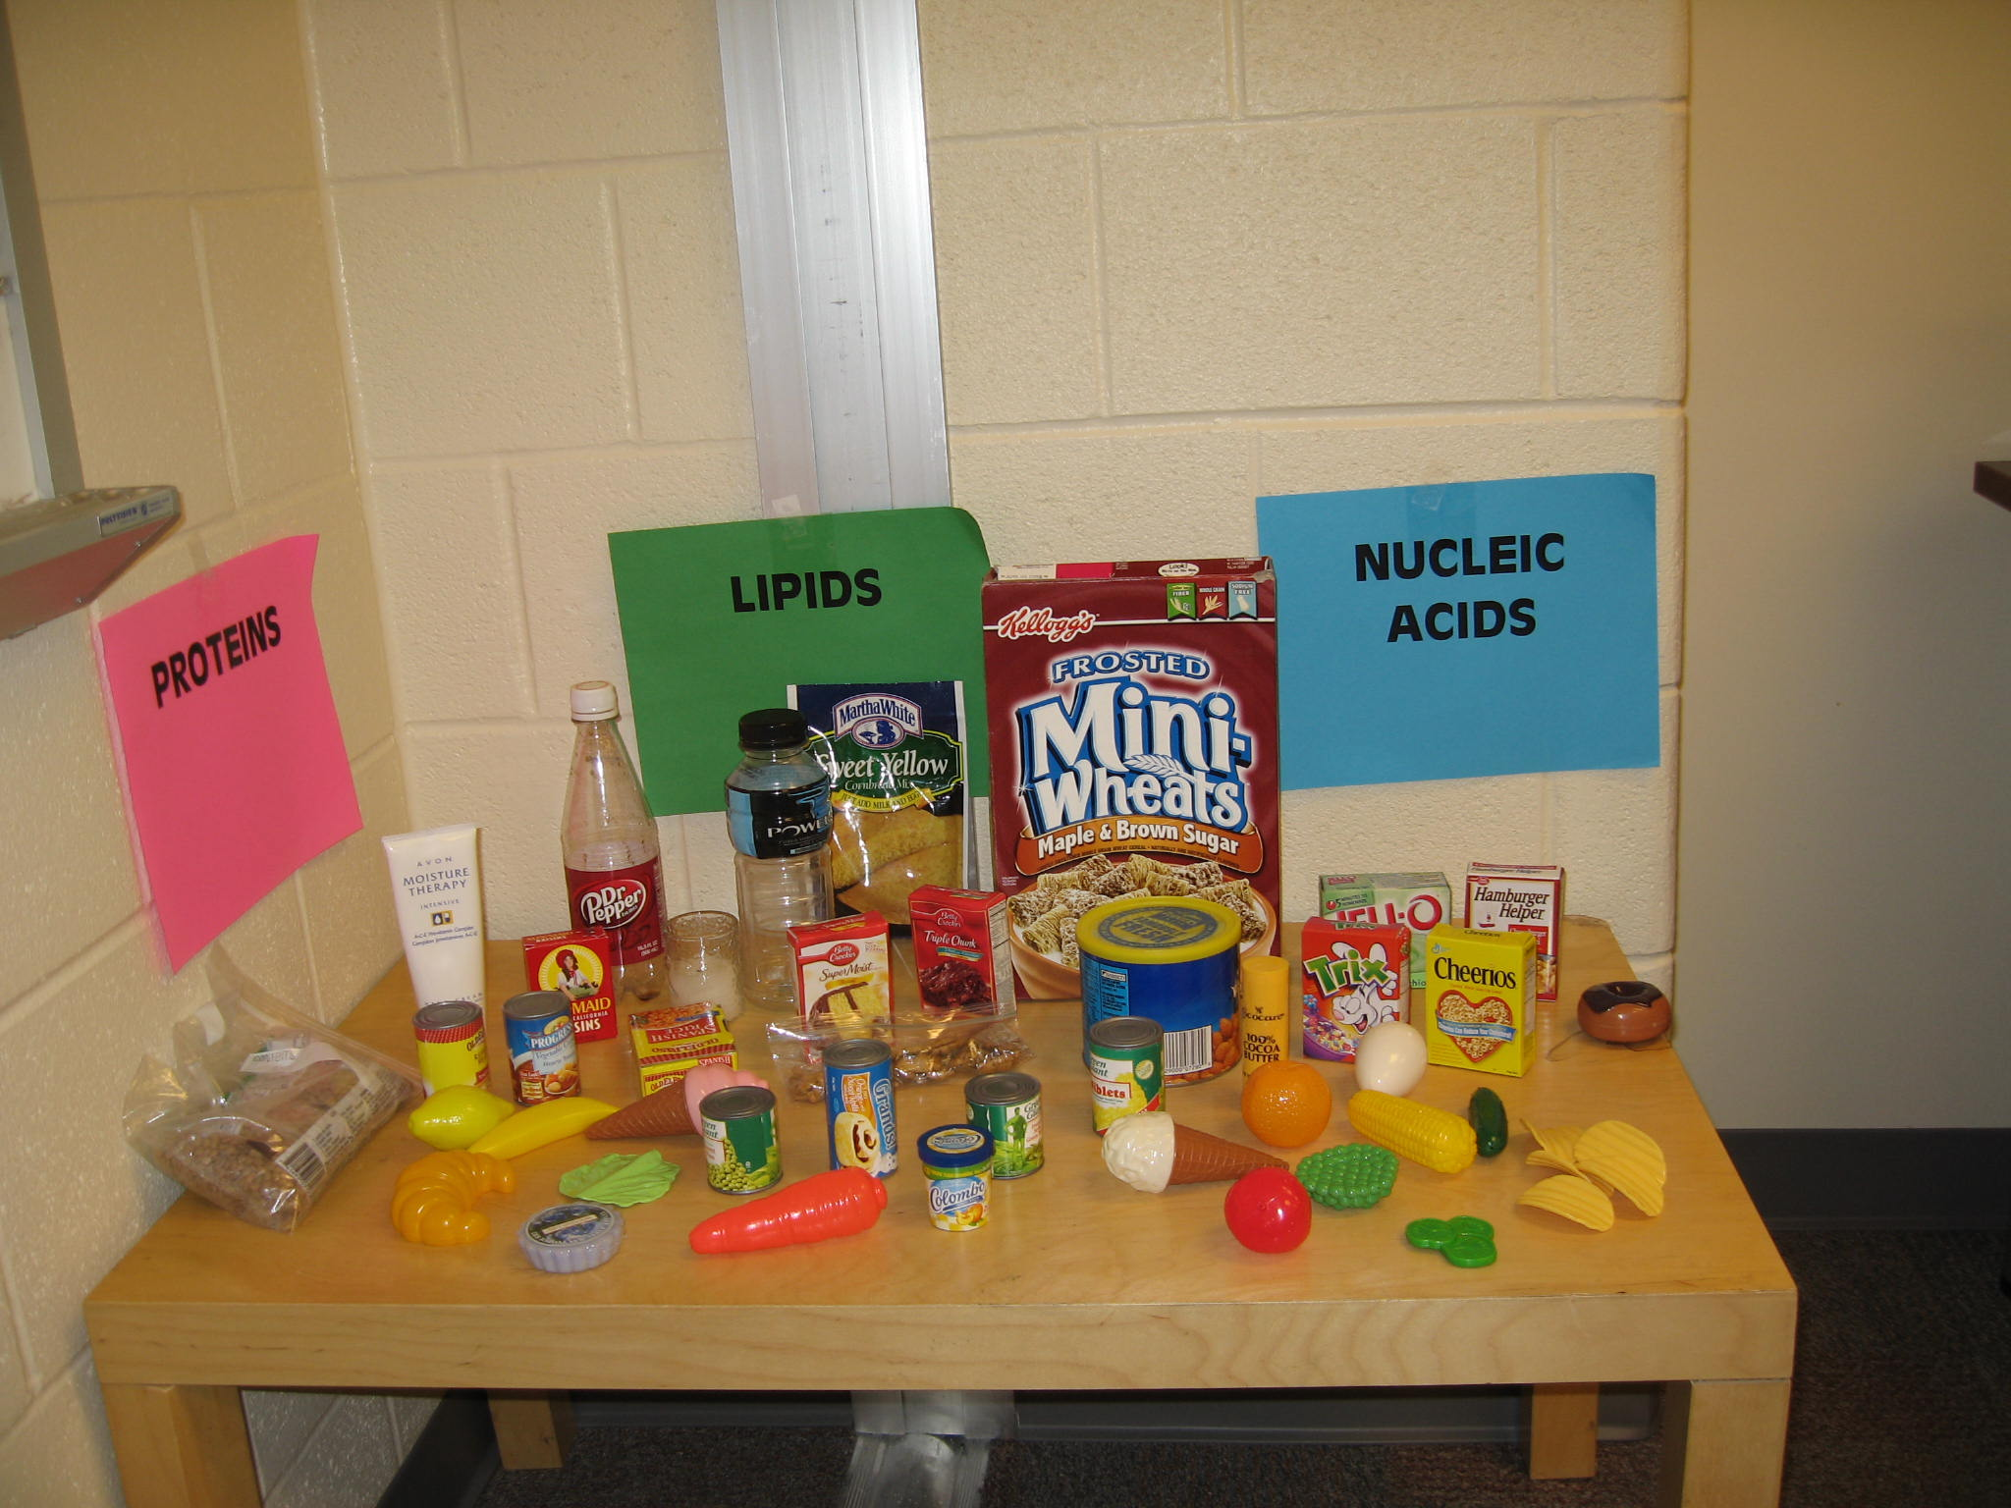
Instructional Idea
Supermarket “shopping” activity
  Sorting items, identifying & explaining properties

Slide 80
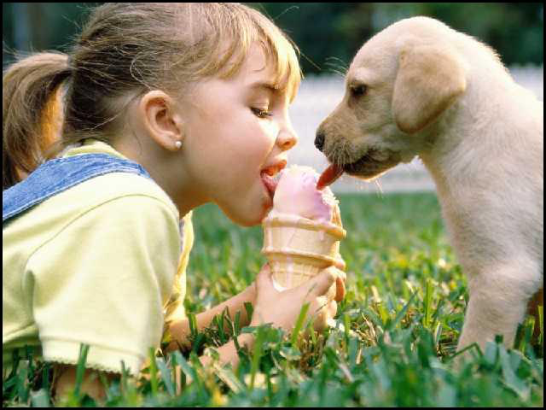
Activities for Content Application: Let’s Share
Share a lesson you taught or observed. Was there an activity that would be memorable for the students? If not, how could the activity have been more engaging and unforgettable?

Slide 81
Activity: Seven Rules of Engagement
Skim through the article and reflect on the seven rules for engagement.
Based on the article’s recommendations, what would consider changing in your teaching practices to motivate ELs to read?

Slide 82
SIOP Component 8:
Review & Assessment
How do you review material & assess students?

Slide 83
Effective Teaching Cycle for
English Learners
Develop lesson
using
CCSS and
SIOP model
Reteach
Teach lesson
Make adjustments to
Improve student
comprehension
Ongoing assessment of
student comprehension
and work
Review key concepts
and vocabulary

Slide 84
Do This
Provide multiple exposures to new terminology to build familiarity, confidence and proficiency.
Paraphrase – it provides and effective scaffold , especially after words and phrases have been previously defined and discussed in context.
Do use pictures and non-print (gestures, role-play, Pictionary, charades.)
Help students become more familiar with academic language through introducing and modeling academic tasks.
Have students create personal Word Study Books

Slide 85
Dynamic Framework:
Helping Teachers Separate Language Difficulty from Disability
Formative & Summative
Progress over Time
Research-based instructional practices
Assessment of student performance
Collaborative teams to examine & reflect on practices
Culturally responsive interventions
Assessment of student performance
Fewer mis-referrals into
special education
PD
PD
English
Language
Learner
PD
Parental Involvement
Formative & Summative
Progress over Time
PD
PD
PD = Professional Development
Parental Involvement

Slide 86
Interventions for Listening, Speaking, Reading, Writing & Cultural Impact
Possible Explanation | In L1 | In English
Listening Lack of Understanding | Listen to stories in L1; preview the story; show objects from the story; have parents tell/read stories on regular basis | Use graphic supports & visuals before during storytelling or read aloud; infuse abundant checks for understanding
Speaking Lack of oral expression | Parents ask child to retell school events on daily basis; have student retell interesting news/movies | Use small group interactions; provide word bank & language needed to recount story
Reading Lack of contextual comprehension | Use books with audio recordings; provide summary or preview in L1; highlight sequential and transitional vocabulary | Preview vocabulary with pictures; provide a sequence graphic organizer during reading; make sure material is at the student’s instructional level
Writing Poor writing skills | Use digital photographs from real-life events, use images for oral narratives that will then be written; use sequential writing frame template
Cultural Impact | Use books that depict C1; teach student the cultural context of the story; pre-teach unfamiliar content
(Adapted from Hamayan et al., 2013)

Slide 87

Language Difficulty or Disability:
Steps to Discern One from the Other
EL experiences difficulty in the classroom
Step 1: Teacher makes use of a variety of instructional strategies to address student’s difficulty & records student progress
Step 2: Teacher requests assistance from in-school problem-solving teams
Step 3: In school problem-solving team develops an intervention plan & timeframe
Step 4: In school-team reevaluates intervention plan and assesses student progress over time
4-6 weeks
With appropriate
data collection
Student continues
experiencing
difficulty

Slide 88
Language Difficulty or Disability:
Steps to Discern One from the Other
EL continues to experience difficulty in the classroom
Step 5a: In school problem-solving team modifies or expands intervention plan & adjusts timeframe OR
Step 5b: In school problem-solving team requests dual language assessment
Step 6: Dual language assessment is conducted to determine appropriate action

Slide 89
Pre-Referral Checklist for ELs
Has the student received appropriate core curriculum instruction that is appropriate for EL students?
Has the student received intensive evidence-based interventions in the area of academic weakness implemented with fidelity over time and demonstrated little or no progress?
Extrinsic factors have been considered (Physical, personal, cultural, learning environment)
Has the team consulted with the parent regarding learning patterns and language use in the home?

Slide 90
Pre-Referral Checklist for ELs Cont’d.
Does the team have data to support that the difficulties (academic, social-emotional, or in speech & language) are most likely due to a disability versus a language difference (i.e., comparative data to like peers, etc.)?
Are the error patterns seen in L1 similar to the patterns seen in L2?
Pre Referral Checklist by J. Butterfield
90

Slide 91
Referral to special education may be appropriate
Referral to special education may not be appropriate
Yes
No

Slide 92
Closure
Please complete the sentences:
  I learned that…
  I wonder…
  I still would like to know…

